Slide 1





VC PART -1
LAST ITERATION - ORGANISATION

Slide 2
EVALUATION
FEEDBACKS ONLY FOR THIS FIRST PART

Slide 3
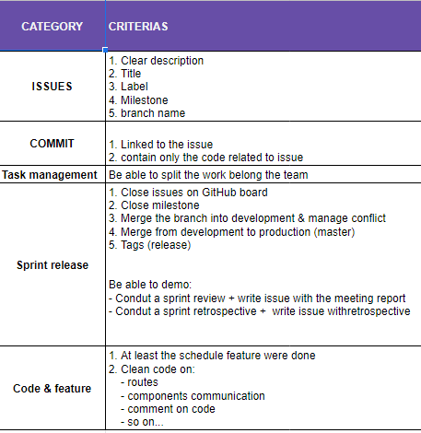
ITERATION 2
EVALUATION
Evaluation

Slide 4
5/6 TOPICS TO PRESENT
1 TOPIC PER STUDENT
TOPIC 1 UX/UI and FEATURES | Explain your features and the reasons of your choices Explain your UX/UI and the reasons of your choices Are you choices have been validated by your customer/PM ?
TOPIC 2 BACK END | Explain your database and the reasons of your choices Explain your routes and the reasons of your choices
TOPIC 3 FRONT END | Explain your component structure/communication and the reasons of your choices
TOPIC 4 TASK MANAGEMENT | How did you divide the tasks between your team members? Take as example as specific iteration
TOPIC 5 AUTO EVALUATION | What are your team great achievements ? What are the points your team great need to improve? Did you use the retrospective to improve your team work?
TOPIC 6 (for teams of6) TECHNICAL | Explain a technical point in details Example: How do you filter events on the explore events view?
FINAL
PRESENTATION
25 MIN PER GROUP
05 MIN PER STUDENT

